Slide 1

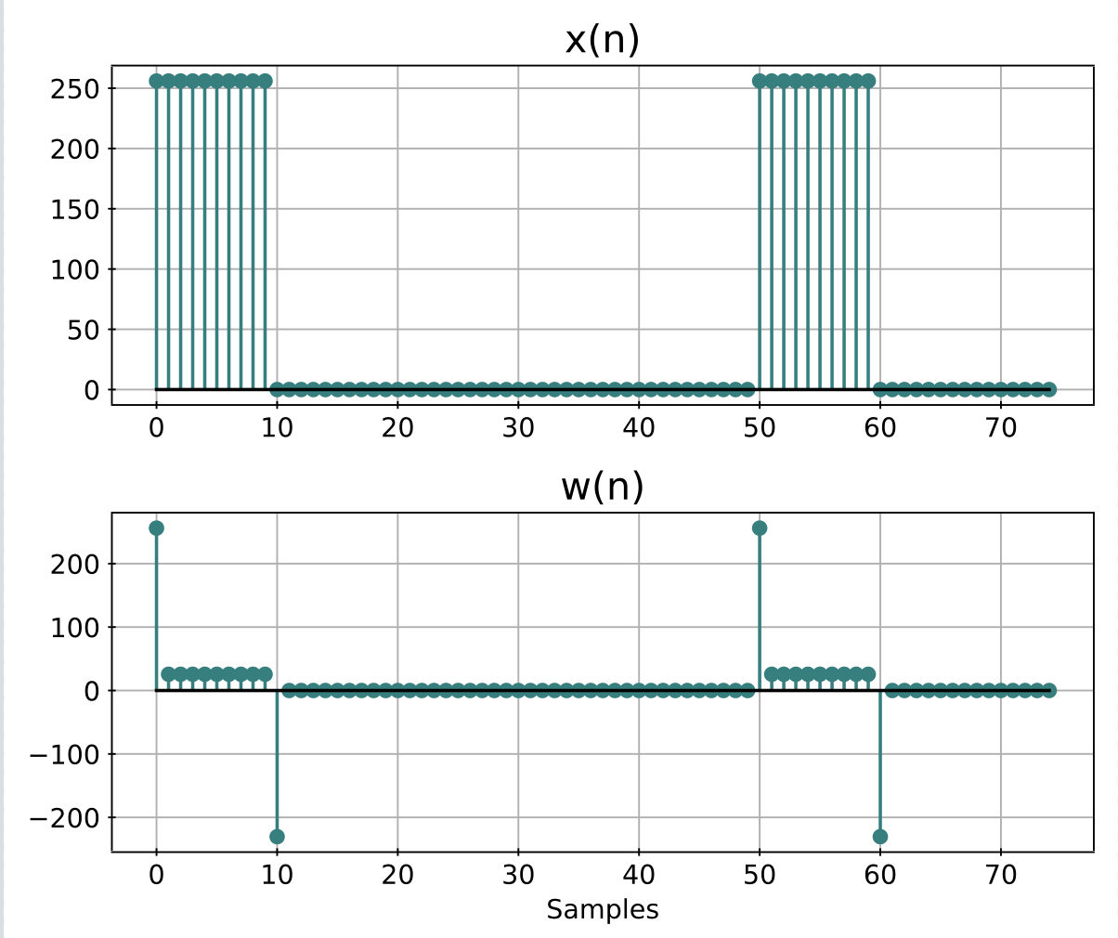
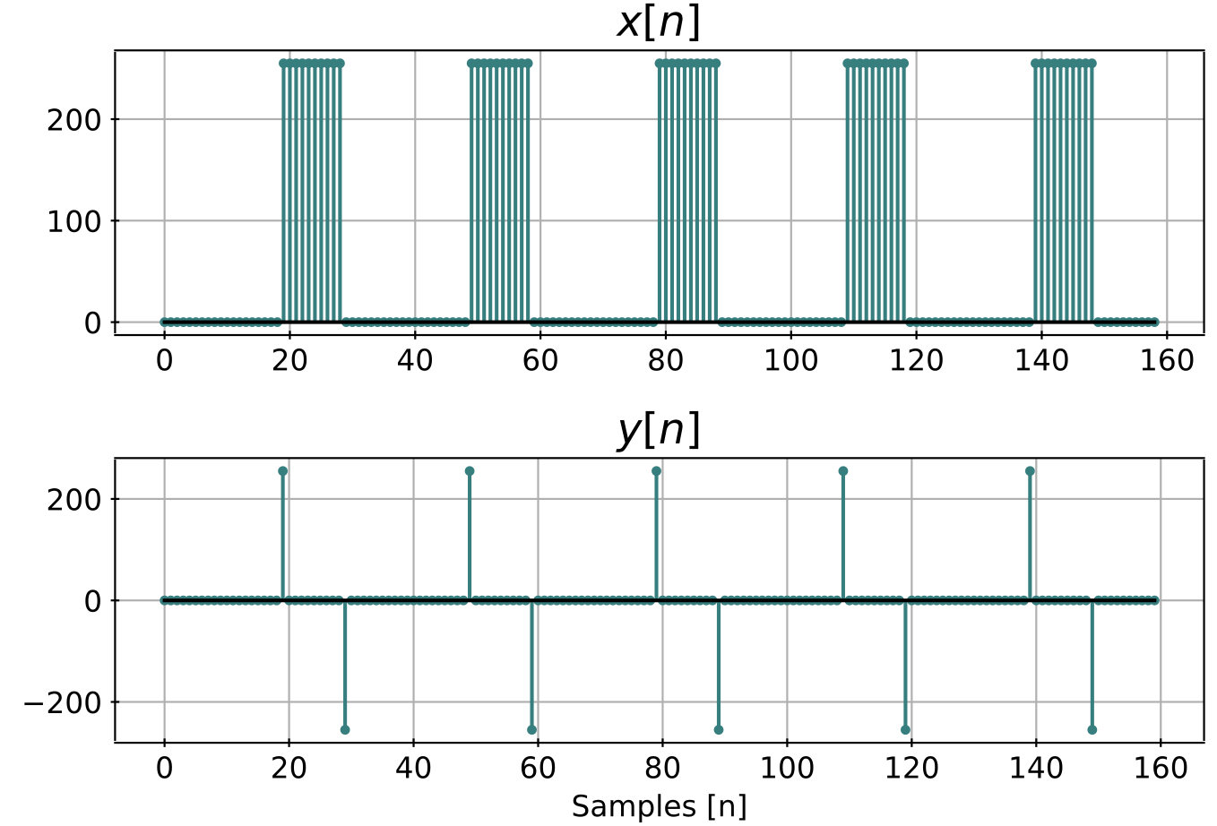
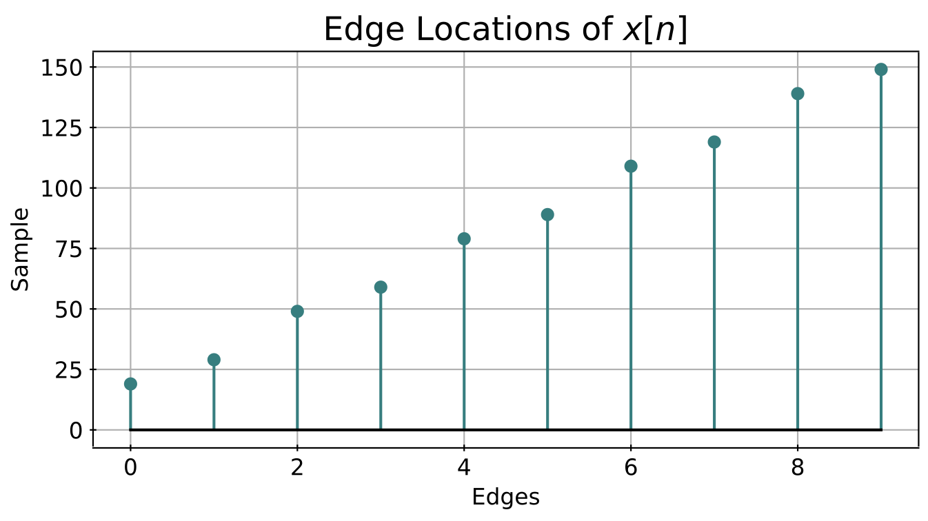
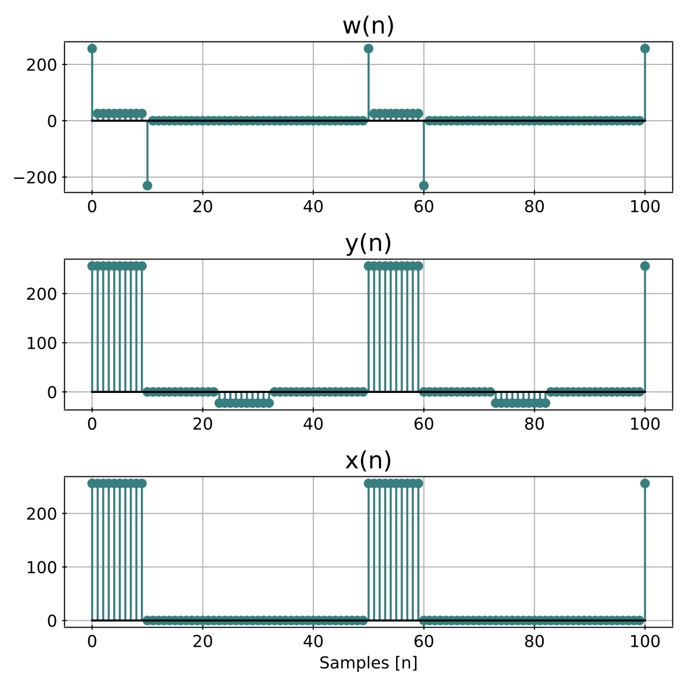
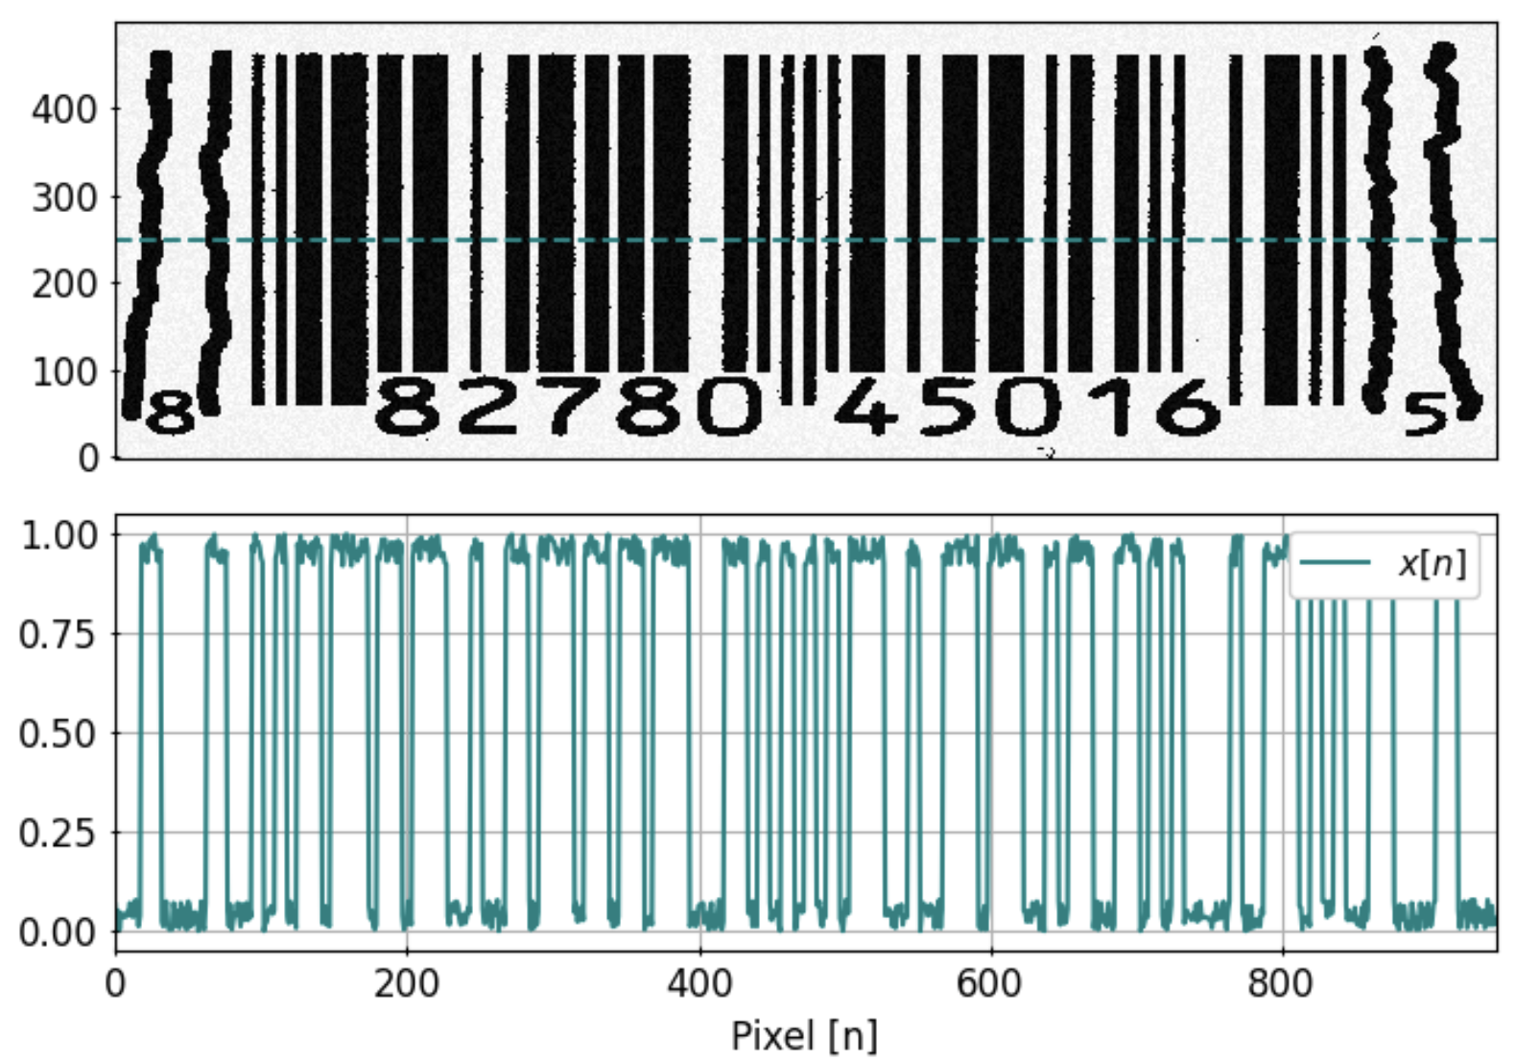
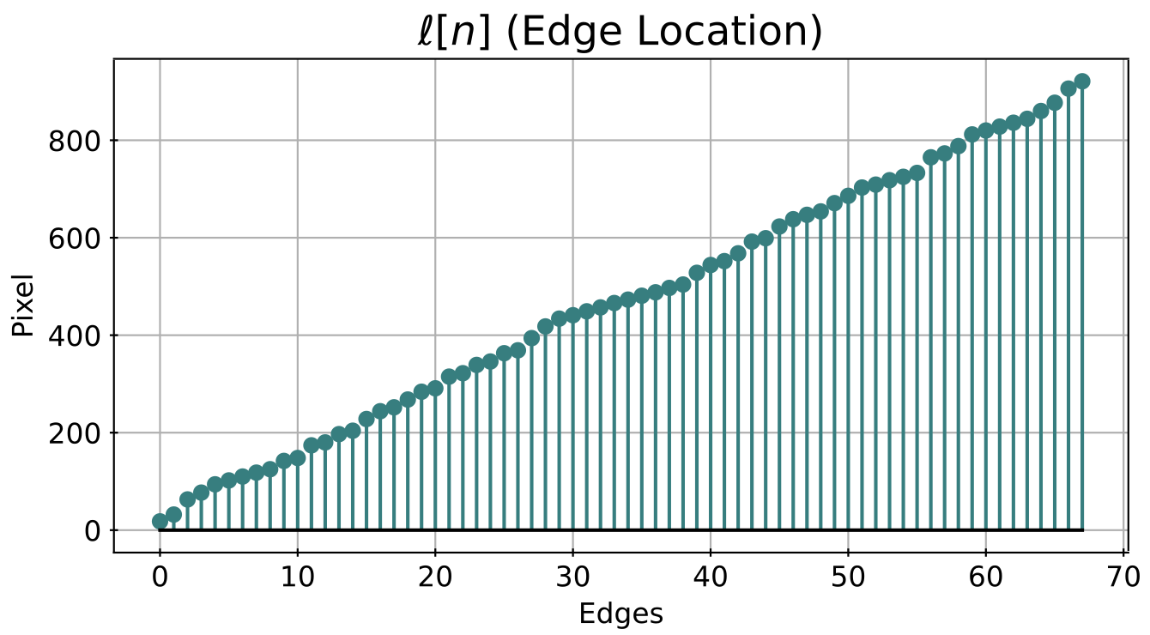
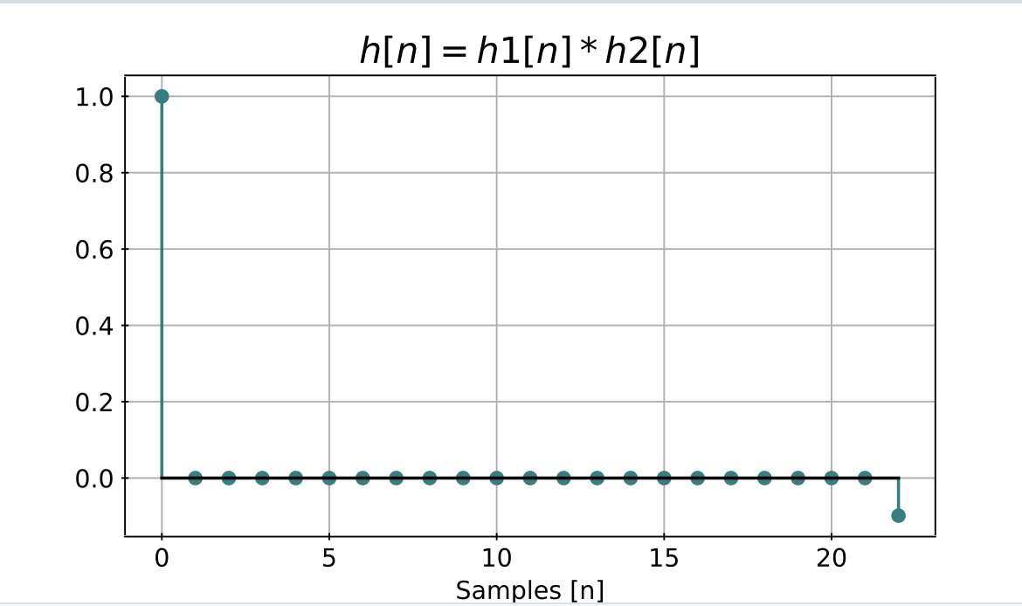
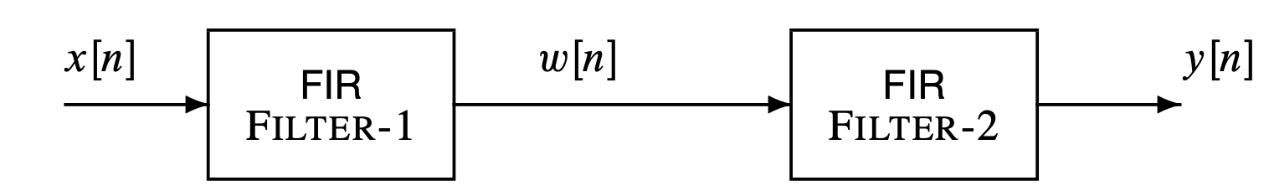
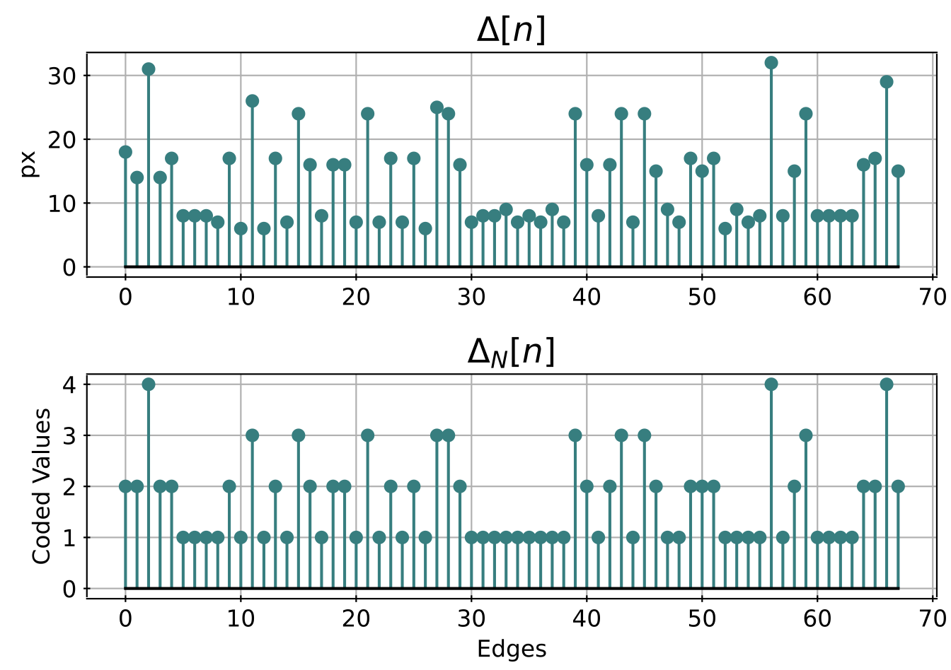
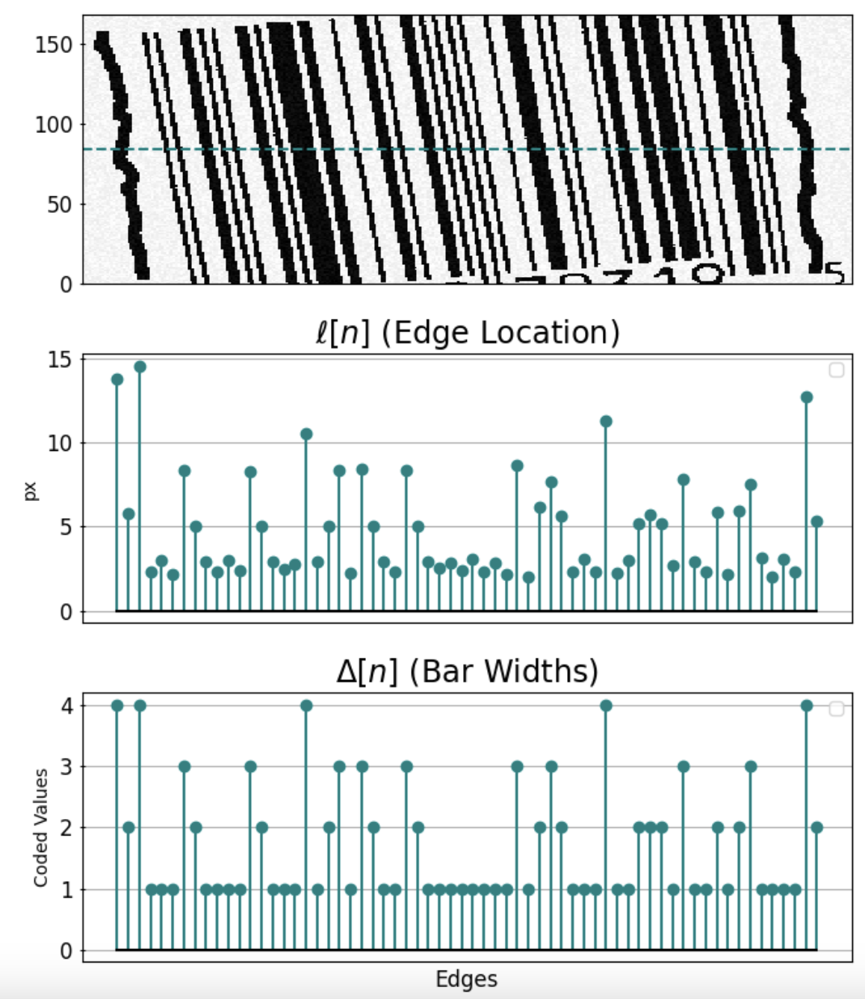
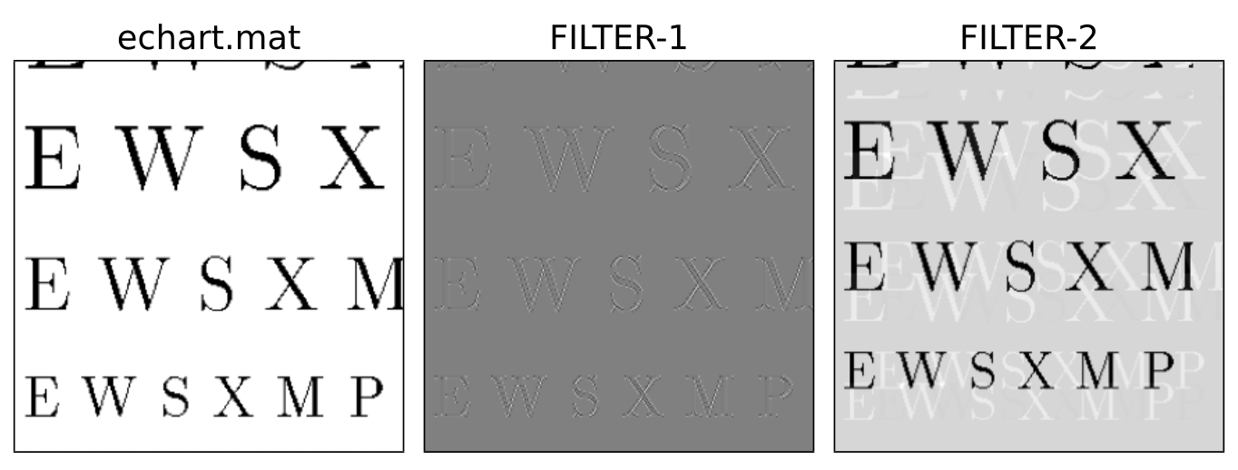
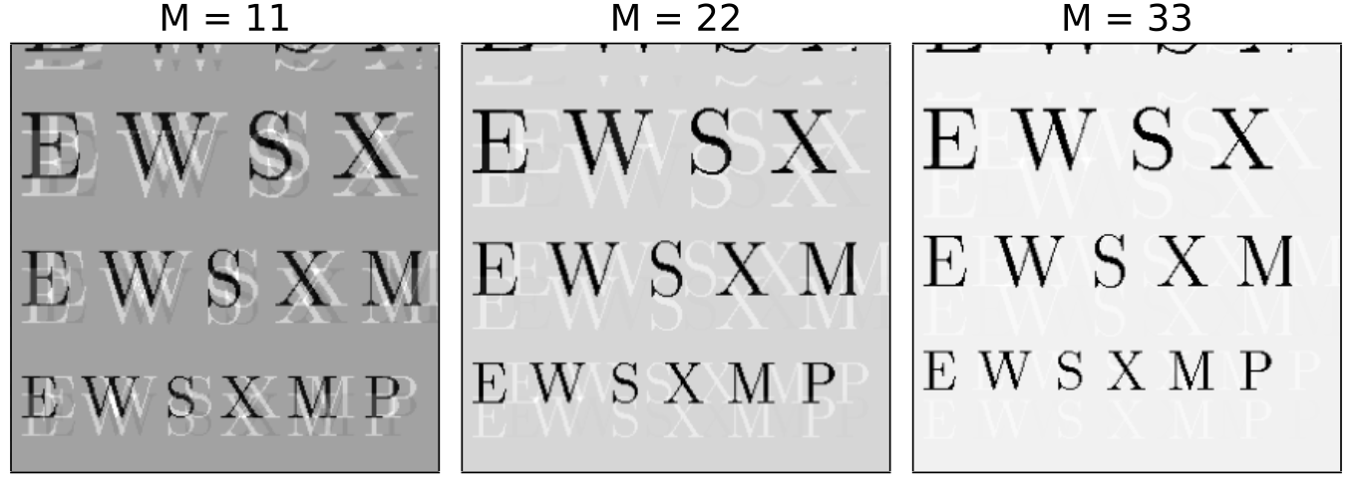
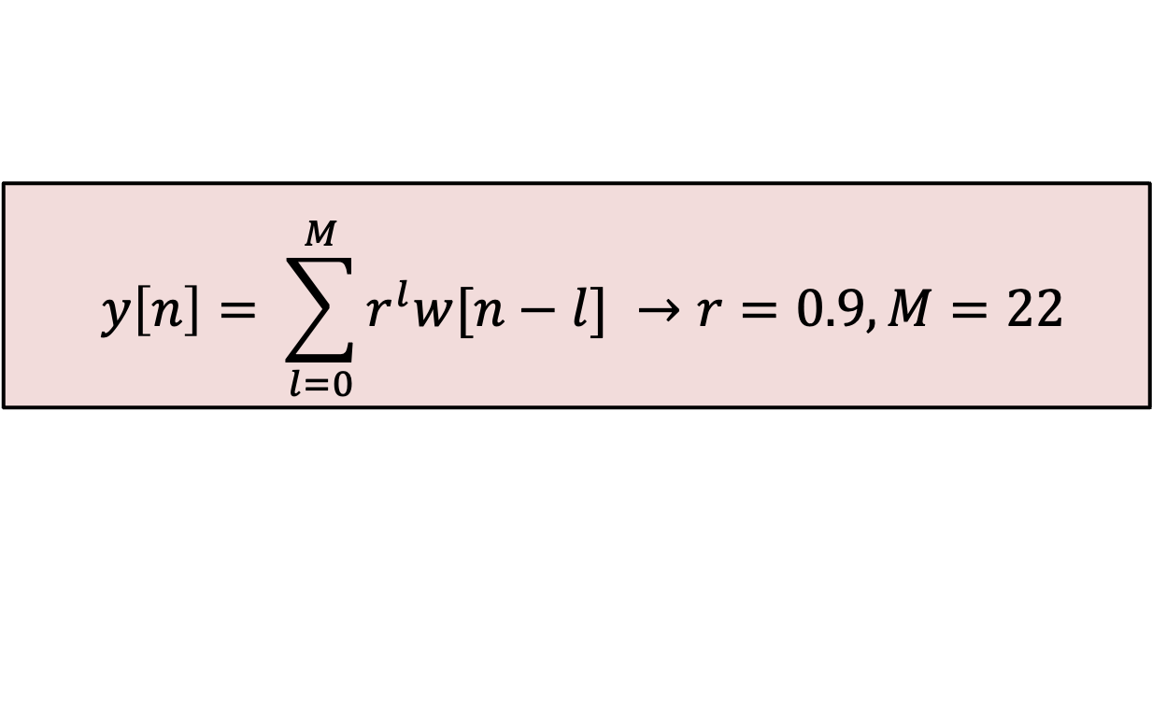
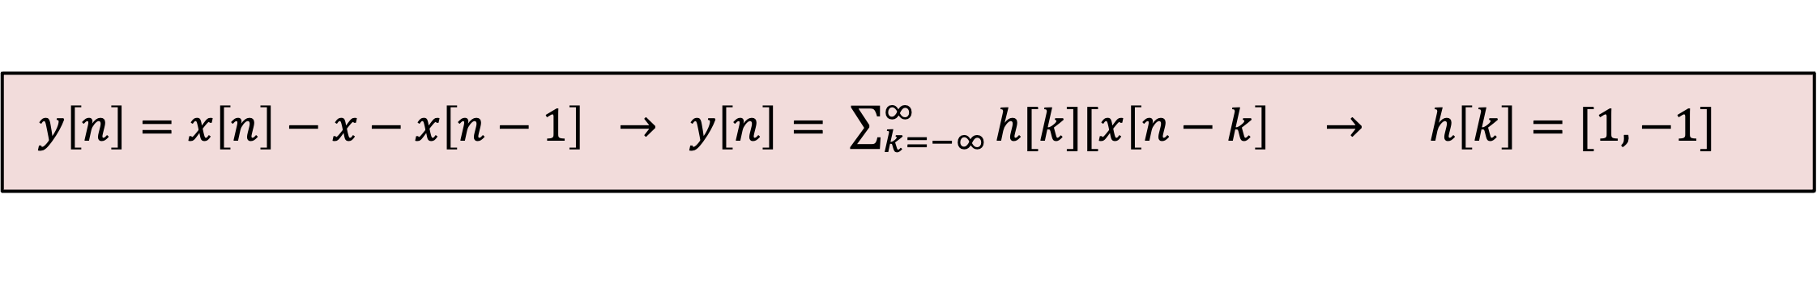
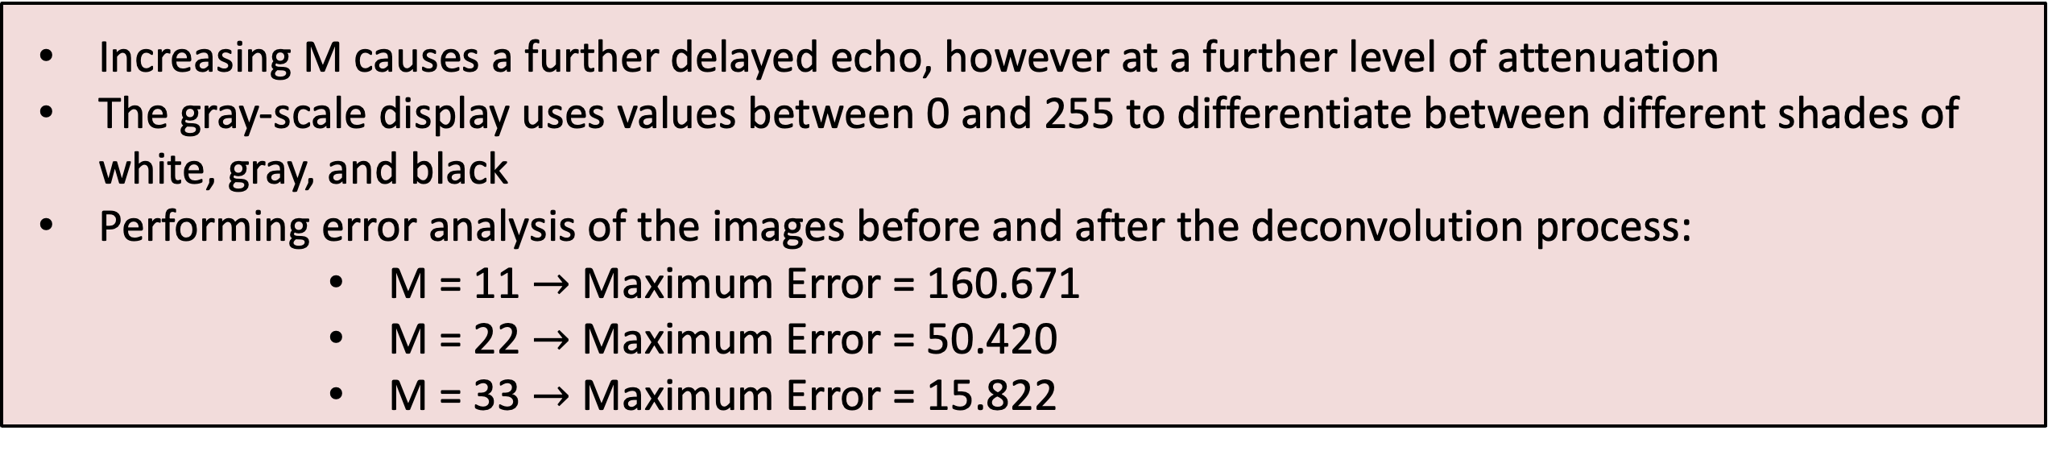
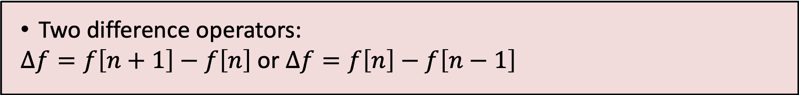

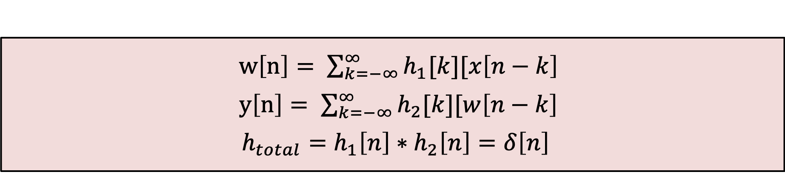

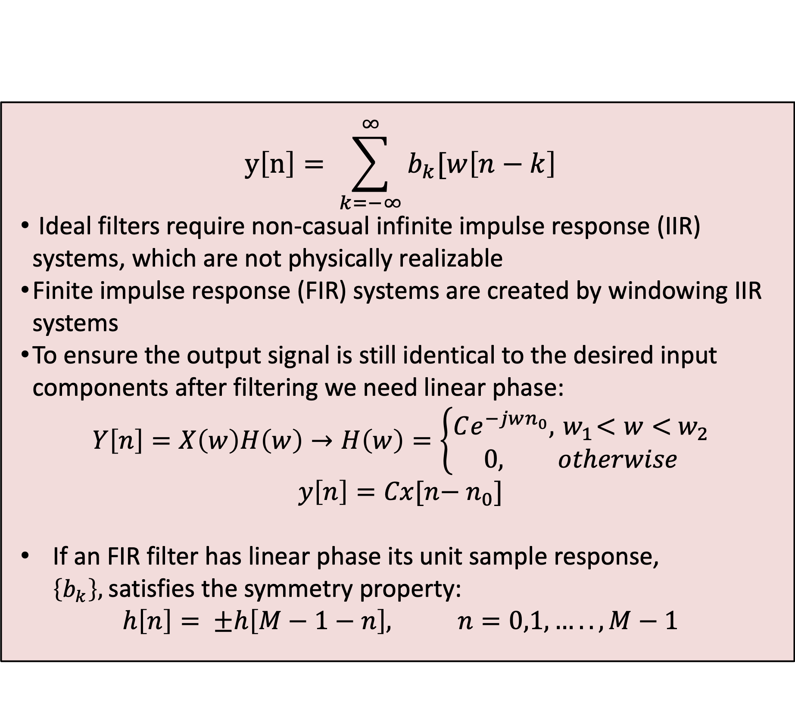
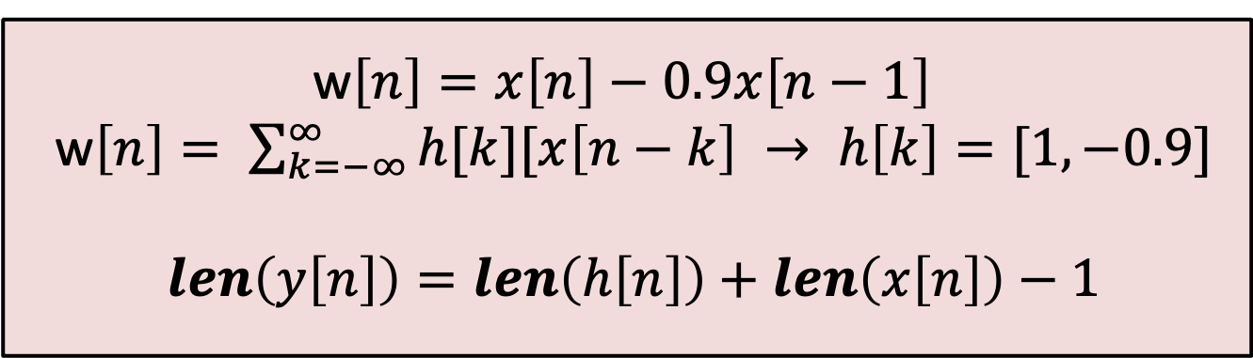
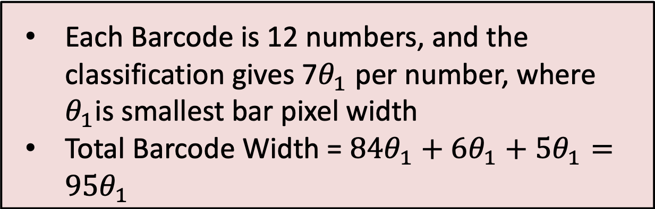
Preparing your poster for printing:
Go to File > Save As. Under Save as type (Windows) or Format (OS X), select PDF.
Open the PDF in Adobe Photoshop. Go to File > Save As. Under Format, select JPEG or TIFF. Choose a location and file name for your file and click Save. Click OK on the default save settings.
DO NOT SAVE TO A JPEG OR TIFF FROM POWERPOINT!
Project Group 3
Grant Brown, Thomas Warren, Rick
Digital Signal Processing
University of Utah
LOGO
INTRODUCTION
LAB 9
LAB 10
Echo Deconvolution Image Processing – Transmission mediums can cause unwanted effects, such additive WGN. To overcome this FIR filters can be used to perform deconvolution, giving the input signal at the output, which is very important in communication systems such as software radios. This lab focuses on the deconvolution process and how it can be applied to images.
Image Detection Lab – Use first order derivate FIR filter to find edge transitions, from the edge transitions we can determine bar length and the associated message
Project Group 3 focused on design of FIR filters and their applications for performing deconvolution and image processing
The project consisted of two labs
Lab 9 - Deconvolution with Audio and Image Processing
Lab 10 – Image Classification
Lab 9 focused on deconvolution and echoing using FIR filters, the results are demonstrated on audio and image processing fronts
Lab 10 utilizes FIR filters to perform discrete derivates which can be used to perform edge detection in images
RESULTS/DISCUSSION
Difference Filter
Destructive Filter
$y\left[n\right]=x\left[n\right]−x−x\left[n−1\right] →$ $y\left[n\right]= \sum_{k=−∞}^{∞}{h[k][x\left[n−k\right] → h\left[k\right]=[1, −1]}$
w$\left[n\right]=x\left[n\right]−0.9x\left[n−1\right]$
w$\left[n\right]= \sum_{k=−∞}^{∞}{h[k][x\left[n−k\right] → h\left[k\right]=[1, −0.9]}$
$$len\left(y\left[n\right]\right)=len\left(h\left[n\right]\right)+len\left(x\left[n\right]\right)−1$$
FIR Filter Background
$$y\left[n\right]= \sum_{k=−∞}^{∞}{b_{k}[w\left[n−k\right]}$$
Ideal filters require non-casual infinite impulse response (IIR) systems, which are not physically realizable
Finite impulse response (FIR) systems are created by windowing IIR systems
To ensure the output signal is still identical to the desired input components after filtering we need linear phase:
$$Y\left[n\right]=X\left(w\right)H\left(w\right)→H\left(w\right)=\left\{\begin{aligned}Ce^{−jwn_{0}},{ w}_{1}<w<{ w}_{2} \\ 0, otherwise\end{aligned}\right.$$
$$y\left[n\right]=Cx[n−{ n}_{0}]$$
If an FIR filter has linear phase its unit sample response, $\left\{b_{k}\right\},$satisfies the symmetry property:
$$h\left[n\right]= ±h\left[M−1−n\right], n=0,1,…..,M−1$$
Barcode Processing
Barcode pixels show 1 for black, 0 for white
Applying the difference filter and using a threshold for the derivate one can find black and white stripe pixel locations
Restoration Filter
$$y\left[n\right]= \sum_{l=0}^{M}{r^{l}w[n−l]} →r=0.9, M=22$$
Total Deconvolution Response
Barcode Classification
$$W\left[z\right]=X\left[z\right]\left(1−0.9z^{−1}\right)$$
$$H_{1}\left(z\right)= \frac{W[z]}{X[z]}= \left(1−0.9z^{−1}\right)$$
$$r\left[n\right]=r^{n}\left(u\left[n\right]−u\left[n−22\right]\right)$$
$$H_{2}\left[z\right]= \sum_{n=0}^{∞}{{\left(\frac{0.9}{z}\right)}^{n}} −{0.9}^{22}z^{−22}\sum_{n=0}^{∞}{{\left(\frac{0.9}{z}\right)}^{n}}$$
$$H_{2}\left[z\right] = \frac{1}{1−0.9z^{−1}}+\frac{{0.9}^{22}z^{−22}}{1−0.9z^{−1}}$$
$$H_{1,2}\left[z\right]= H_{1}\left(z\right) ∗H_{2}\left[z\right]=1+{0.9}^{22}z^{−22}$$
$$h_{1,2}\left[n\right]= δ\left[n\right]+{0.9}^{22}δ\left[n\right]$$
0 = 3-2-1-1 5 = 1-2-3-1
1 = 2-2-2-1 6 = 1-1-1-4
2 = 2-1-2-2 7 = 1-3-1-2
3 = 1-4-1-1 8 = 1-2-1-3
4 = 1-1-3-2 9 = 3-1-1-2
Deconvolution
$w\left[n\right]= \sum_{k=−∞}^{∞}{h_{1}[k][x\left[n−k\right]}$
$y\left[n\right]= \sum_{k=−∞}^{∞}{h_{2}[k][w\left[n−k\right]}$
$$h_{total}=h_{1}\left[n\right]∗h_{2}\left[n\right]=δ\left[n\right]$$
Echo Filter
$$y\left[n\right]=x\left[n\right]+rx[n−P]$$
$τ= 0.2 s , f_{s}=8 KHz, Echo= 90\%→. y\left[n\right]=x\left[n\right]−0.9x[n−1600$]
$$b_{k}=[1;zeros\left(1599,1\right), 0.9]$$
Discrete Derivative
Barcode Length
Two difference operators:
$Δf=f\left[n+1\right]−f\left[n\right]$ or $Δf=f\left[n\right]−f\left[n−1\right]$
Each Barcode is 12 numbers, and the classification gives 7$θ_{1}$ per number, where $θ_{1}$is smallest bar pixel width
Total Barcode Width = $84θ_{1}+6θ_{1}+5θ_{1}=95θ_{1}$
Contribution
Lab 9 – Grant and Thomas
Lab 10 – Rick
Poster – Grant
GitHub – Rick, Grant, and Thomas
Final Submission – Rick, Grant, and Thomas
https://github.com/GrantBrown1994/DSP_Project
Barcode Length Averaging
Increasing M causes a further delayed echo, however at a further level of attenuation
The gray-scale display uses values between 0 and 255 to differentiate between different shades of white, gray, and black
Performing error analysis of the images before and after the deconvolution process:
M = 11 $→$ Maximum Error = 160.671
M = 22 $→$ Maximum Error = 50.420
M = 33 $→$ Maximum Error = 15.822
The image is slanted, therefore if image is deciphered using one row the results can be incorrect due to edge elongation
Grabbing multiple rows and averaging gives an approximation of the row length which can be used to decipher the message

